Slide 1
CSCE 5580 – Computer Networks Instructor: Tao Wang

Slide 2

Network layer: “data plane” roadmap
Network layer: overview
data plane
control plane
What’s inside a router
input ports, switching, output ports
buffer management, scheduling
IP: the Internet Protocol
datagram format
addressing
network address translation
IPv6
Generalized Forwarding, SDN
Match+action
OpenFlow: match+action in action
Middleboxes
Notes:
Our home router is connected to one external and other internal devices.
Data plan: The data coming from an external device, to which internal device it should be sent.
Control Plan: The best route to route the packet from source to destination.
These two things should be combined.

Slide 3








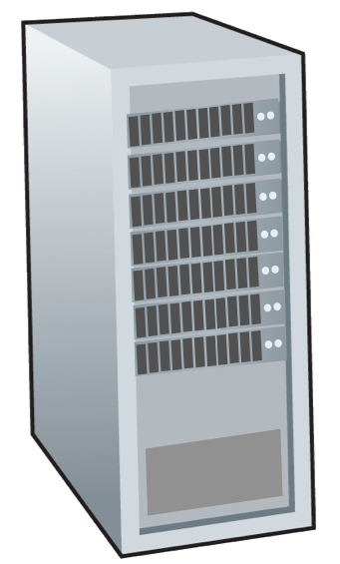







Network-layer services and protocols
transport segment from sending to receiving host
sender: encapsulates segments into datagrams, passes to link layer
receiver: delivers segments to transport layer protocol
network layer protocols in every Internet device: hosts, routers
routers:
examines header fields in all IP datagrams passing through it
moves datagrams from input ports to output ports to transfer datagrams along end-end path
mobile network
national or global ISP
application
transport
network
link
physical
network
link
physical
network
link
physical
network
link
physical
network
link
physical
network
link
physical
datacenter
network
application
transport
network
link
physical
enterprise
network
Notes:
They determine routing and forwarding.
Internet is not a single-hop communication.
This is close to the physical device.

Slide 4

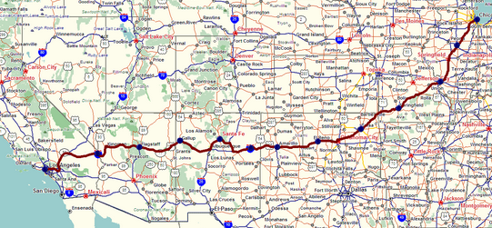
Two key network-layer functions
network-layer functions:
forwarding: move packets from a router’s input link to appropriate router output link
analogy: taking a trip
forwarding: process of getting through single interchange
routing: process of planning trip from source to destination
routing: determine route taken by packets from source to destination
routing algorithms
forwarding
routing
Notes:
Usually, at home, we have one outgoing link.
Forwarding: Which outgoing links should the packet go from?
Forward from one router to another – this is a one-hop communication.
Routing: Which is the best route?
All routers work together.

Slide 5
Network layer: data plane, control plane
Data plane:
local, per-router function
determines how datagram arriving on router input port is forwarded to router output port
Control plane
network-wide logic
determines how datagram is routed among routers along end-end path from source host to destination host
values in arriving
packet header
two control-plane approaches:
traditional routing algorithms: implemented in routers
software-defined networking (SDN): implemented in (remote) servers
0111
1
3
2

Slide 6

Per-router control plane
Individual routing algorithm components in each and every router interact in the control plane
Routing
Algorithm
control
plane
data
plane
values in arriving
packet header
0111
1
3
2
Notes:
Out of 3 outgoing links, which one should it pick to forward – All routers will figure out together the route from source to destination.

Slide 7
Software-Defined Networking (SDN) control plane
Remote controller computes, installs forwarding tables in routers
Remote Controller
control
plane
data
plane
CA
CA
CA
CA
CA
values in arriving
packet header
0111
1
3
2
Notes:
Send the information to the remote control, and that will decide the best route.
Change the forwarding table dynamically, so centralized will be better to monitor.

Slide 8
Network service model
Q: What service model for “channel” transporting datagrams from sender to receiver?
example services for individual datagrams:
guaranteed delivery
guaranteed delivery with less than 40 msec delay
example services for a flow of datagrams:
in-order datagram delivery
guaranteed minimum bandwidth to flow
restrictions on changes in inter-packet spacing

Slide 9
Network-layer service model
Quality of Service (QoS) Guarantees ?
Network
Architecture
Internet
ATM
ATM
Internet
Internet
Service
Model
best effort
Constant Bit Rate
Available Bit Rate
Intserv Guaranteed
(RFC 1633)
Diffserv (RFC 2475)
Bandwidth
none
Constant rate
Guaranteed min
yes
possible
Loss
no
yes
no
yes
possibly
Order
no
yes
yes
yes
possibly
Timing
no
yes
no
yes
no
Internet “best effort” service model
No guarantees on:
successful datagram delivery to destination
timing or order of delivery
bandwidth available to end-end flow
Notes:
We don’t provide any guarantee.

Slide 10
Network-layer service model
Quality of Service (QoS) Guarantees ?
Network
Architecture
Internet
ATM
ATM
Internet
Internet
Service
Model
best effort
Constant Bit Rate
Available Bit Rate
Intserv Guaranteed
(RFC 1633)
Diffserv (RFC 2475)
Bandwidth
none
Constant rate
Guaranteed min
yes
possible
Loss
no
yes
no
yes
possibly
Order
no
yes
yes
yes
possibly
Timing
no
yes
no
yes
no

Slide 11
Reflections on best-effort service:
simplicity of mechanism has allowed Internet to be widely deployed adopted
sufficient provisioning of bandwidth allows performance of real-time applications (e.g., interactive voice, video) to be “good enough” for “most of the time”
replicated, application-layer distributed services (datacenters, content distribution networks) connecting close to clients’ networks, allow services to be provided from multiple locations
congestion control of “elastic” services helps

Slide 12
Network layer: “data plane” roadmap
Network layer: overview
data plane
control plane
What’s inside a router
input ports, switching, output ports
buffer management, scheduling
IP: the Internet Protocol
datagram format
addressing
network address translation
IPv6
Generalized Forwarding, SDN
Match+action
OpenFlow: match+action in action
Middleboxes

Slide 13
Router architecture overview
high-level view of generic router architecture:
routing, management
control plane (software)
operates in millisecond
time frame
routing
processor
forwarding data plane (hardware) operates in nanosecond timeframe
high-speed
switching
fabric
router input ports
router output ports
Notes:
For home routes, this will be different.
Green – Physical layer
Blue – Link layer
Red- Network layer

Slide 14


Input port functions
lookup,
forwarding
queueing
line
termination
link
layer
protocol
(receive)
switch
fabric
physical layer:
bit-level reception
Datagram
decentralized switching:
using header field values, lookup output port using forwarding table in input port memory (“match plus action”)
goal: complete input port processing at ‘line speed’
input port queuing: if datagrams arrive faster than forwarding rate into switch fabric
link layer:
e.g., Ethernet
(chapter 6)
Frame
Notes:
Green box is a physical layer responsible for receiving bit level transmission. Copper, fiber wireless.
Link layer in blue – bit assemble into Ethernet frame. We will discuss this in details in chapter 6.
But most critical one, is here. Lookup, forwarding function. Lookup and forward is “Match plus action” behavior.
GOAL – processing at “line speed”, otherwise, buffer will be full and packet will be lost

Slide 15
Input port functions
lookup,
forwarding
queueing
line
termination
link
layer
protocol
(receive)
switch
fabric
physical layer:
bit-level reception
decentralized switching:
using header field values, lookup output port using forwarding table in input port memory (“match plus action”)
destination-based forwarding: forward based only on destination IP address (traditional)
generalized forwarding: forward based on any set of header field values
link layer:
e.g., Ethernet
(chapter 6)

Slide 16
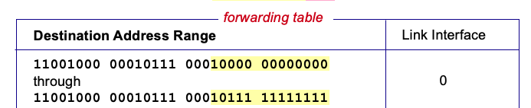

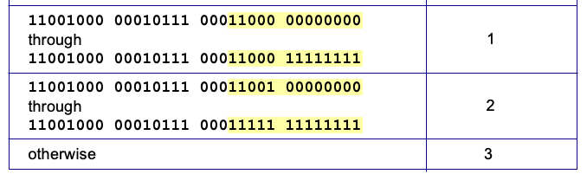
Destination-based forwarding
3
Q: but what happens if ranges don’t divide up so nicely?
Notes:
Text for this animation:
This all works out pretty nice and looks pretty simple!
But of course the devil is in the details, as the saying goes.
What happens, for example, when a subset of addresses say in this first range should go to say interface 3, rather than interface 0. Well, of course we could split the first address range into multiple pieces, and add in this new subrange with its new destination output port. But it turns out there’s a much simpler and elegant way to do this. Known as longest prefix matching.
N/w path (White), host path(Yellow)
If higher bits match we forward the packet. We ignore the lower bits.

Slide 17
Longest prefix matching
longest prefix match
when looking for forwarding table entry for given destination address, use longest address prefix that matches destination address.
Destination Address Range
11001000 00010111 00010
11001000 00010111 00011000
11001000 00010111 00011
otherwise
Link interface
0
1
2
3
***
********
********
***
********
examples:
11001000 00010111 00010110 10100001
which interface?
11001000 00010111 00011000 10101010
which interface?
Notes:
If we find two matches, we always go with the longest one.
Example:
1st packet – Link 0
2nd packet – Link 1

Slide 18
Longest prefix matching
longest prefix match
when looking for forwarding table entry for given destination address, use longest address prefix that matches destination address.
Destination Address Range
11001000 00010111 00010
11001000 00010111 00011000
11001000 00010111 00011
otherwise
Link interface
0
1
2
3
***
********
********
match!
***
********
examples:
11001000 00010111 00010110 10100001
which interface?
11001000 00010111 00011000 10101010
which interface?

Slide 19
Longest prefix matching
longest prefix match
when looking for forwarding table entry for given destination address, use longest address prefix that matches destination address.
Destination Address Range
11001000 00010111 00010
11001000 00010111 00011000
11001000 00010111 00011
otherwise
Link interface
0
1
2
3
***
********
********
***
********
match!
examples:
11001000 00010111 00010110 10100001
which interface?
11001000 00010111 00011000 10101010
which interface?

Slide 20
Longest prefix matching
longest prefix match
when looking for forwarding table entry for given destination address, use longest address prefix that matches destination address.
Destination Address Range
11001000 00010111 00010
11001000 00010111 00011000
11001000 00010111 00011
otherwise
Link interface
0
1
2
3
***
********
********
***
********
match!
examples:
11001000 00010111 00010110 10100001
which interface?
11001000 00010111 00011000 10101010
which interface?

Slide 21
Network layer: “data plane” roadmap
Network layer: overview
data plane
control plane
What’s inside a router
input ports, switching, output ports
buffer management, scheduling
IP: the Internet Protocol
datagram format
addressing
network address translation
IPv6
Generalized Forwarding, SDN
match+action
OpenFlow: match+action in action
Middleboxes

Slide 22
Network Layer: Internet
host, router network layer functions:
transport layer: TCP, UDP
IP protocol
datagram format
addressing
packet handling conventions
Path-selection algorithms: implemented in
routing protocols (OSPF, BGP)
SDN controller
network
layer
forwarding
table
ICMP protocol
error reporting
router “signaling”
link layer
physical layer
Notes:
Path-selection algorithms: The shortest path from source to destination
Forward the packet to the next router.
ICMP: Internet control message protocol. Ex: Check whether a router is available or not (Send a ping message). Use to identify which routes are available and which are not Also figure out the round trip.

Slide 23
IP Datagram format
32 bits
IP protocol version number
head.
len
type of
service
total datagram
length (bytes)
ver
length
header length(bytes)
“type” of service:
diffserv (0:5)
ECN (6:7)
flgs
fragment
offset
fragmentation/
reassembly
16-bit identifier
time to
live
upper
layer
header
checksum
header checksum
TTL: remaining max hops
(decremented at each router)
source IP address
32-bit source IP address
destination IP address
Maximum length: 64K bytes
Typically: 1500 bytes or less
upper layer protocol (e.g., TCP or UDP)
32-bit destination IP address
overhead
options (if any)
e.g., timestamp, record route taken
20 bytes of TCP
20 bytes of IP
= 40 bytes + app layer overhead for TCP+IP
payload data
(variable length,
typically a TCP
or UDP segment)
Notes:
Ver: Always IPv4 if we use this datagram. IPv6 does not have the fragmentation things.
Options: Record all the routers the packet goes through.
Type of service: What type of servers include? 0:5 or 6:7 indicate priorities.
The datagram has a maximum size limit.
Different routes have different capabilities, considering the packet size.
If the next route does not accept that big-sized packet, then the packet is divided into fragments, and to identify the fragments, we use fragment offset. 1st fragment offset is 0.
Time to live: This is the life time of a packet.
How many hops that packet can survive.
Upper layer : Indicate upper layer protocols.
Header checksum: Check integrity.

Slide 24

IP addressing: introduction
223.1.1.1
IP address: 32-bit identifier associated with each host or router interface
interface: connection between host/router and physical link
router’s typically have multiple interfaces
host typically has one or two interfaces (e.g., wired Ethernet, wireless 802.11)
223.1.2.1
223.1.1.2
223.1.1.4
223.1.2.9
223.1.1.3
223.1.3.27
223.1.2.2
223.1.3.1
223.1.3.2
dotted-decimal IP address notation:
223.1.1.1 = 11011111 00000001 00000001 00000001
223
1
1
1
Notes:
An IP address is not assigned to each device. It is assigned to the interface.
It is assigned to a network client.
If we have multiple interfaces then we will have multiple IP addresses.

Slide 25
IP addressing: introduction
223.1.1.1
IP address: 32-bit identifier associated with each host or router interface
interface: connection between host/router and physical link
router’s typically have multiple interfaces
host typically has one or two interfaces (e.g., wired Ethernet, wireless 802.11)
223.1.2.1
223.1.1.2
223.1.1.4
223.1.2.9
223.1.1.3
223.1.3.27
223.1.2.2
223.1.3.1
223.1.3.2
dotted-decimal IP address notation:
223.1.1.1 = 11011111 00000001 00000001 00000001
223
1
1
1

Slide 26
IP addressing: introduction
223.1.1.1
Q: how are interfaces actually connected?
223.1.2.1
223.1.1.2
A: we’ll learn about that in chapters 6, 7
A: wired
Ethernet interfaces connected by Ethernet switches
223.1.1.4
223.1.2.9
223.1.1.3
223.1.3.27
223.1.2.2
223.1.3.1
223.1.3.2
For now: don’t need to worry about how one interface is connected to another (with no intervening router)
A: wireless WiFi interfaces connected by WiFi base station

Slide 27
Subnets
223.1.1.1
What’s a subnet ?
device interfaces that can physically reach each other without passing through an intervening router
223.1.2.1
223.1.1.2
223.1.1.4
223.1.2.9
223.1.1.3
223.1.3.27
223.1.2.2
IP addresses have structure:
subnet part: devices in same subnet have common high order bits
host part: remaining low order bits
223.1.3.1
223.1.3.2
network consisting of 3 subnets
Notes:
If all devices can communicate in one hop without going to the router, it is in the subnetwork.
Left-side 3 devices are in the same subnetwork.
If the device is connected to a switch, it doesn't matter.
Switch is transparent.
If we have switch also it is in same sub network.

Slide 28
IP addressing: CIDR
CIDR: Classless InterDomain Routing (pronounced “cider”)
subnet portion of address of arbitrary length
address format: a.b.c.d/x, where x is # bits in subnet portion of address
subnet
part
host
part
11001000 00010111 00010000 00000000
200.23.16.0/23
Notes:
If 1st 23 bits are the same, then they belong to the same subnet
Network part: 1st 23 bits.
The remaining 9 bits indicate the host.
It can have 2^9 = 512-1-1 = 510 devices.
We use 23 bits for the subnet.

Slide 29
Subnets
subnet 223.1.1.0/24
223.1.1.1
subnet 223.1.2.0/24
Recipe for defining subnets:
detach each interface from its host or router, creating “islands” of isolated networks
each isolated network is called a subnet
223.1.2.1
223.1.1.2
223.1.1.4
223.1.2.9
223.1.1.3
223.1.3.27
223.1.2.2
subnet
223.1.3.0/24
223.1.3.1
223.1.3.2
subnet mask: /24
(high-order 24 bits: subnet part of IP address)
Notes:
For this example, we use 1st 24 bits as the network part.

Slide 30
Subnets
223.1.1.2
subnet 223.1.1/24
where are the subnets?
what are the /24 subnet addresses?
223.1.1.1
223.1.1.4
223.1.1.3
223.1.9.2
223.1.7.0
subnet 223.1.7/24
subnet 223.1.9/24
223.1.9.1
223.1.7.1
223.1.8.1
223.1.8.0
subnet 223.1.2/24
223.1.2.6
subnet 223.1.8/24
223.1.3.27
subnet 223.1.3/24
223.1.2.1
223.1.2.2
223.1.3.1
223.1.3.2
Notes:
1. 6 – Routes are also subnets

